Slide 1
Second eigenvalue of the Laplacian matrix for predicting RNA conformational switch by mutation
Danny Barash
BIOINFORMATICS, Vol. 20, no. 12, 2004,pp. 1861–1869
Presenter : Hsiao-Yen Chang
Data : January 18, 2007

Slide 2
ABSTRACT
Motivation: Conformational switching in RNAs is thought to be
of fundamental importance in several biological processes,
including translational regulation, regulation of self-cleavage in
viruses, protein biosynthesis and mRNA splicing. Current
methods for detecting bi-stable RNAs that can lead to structural
switching when triggered by an outside event rely on kinetics,
energetics and properties of the combinatorial structure space of
RNAs. Based on these properties, tools have been developed to
predict whether a given sequence folds to a structure
characterized by a bi-stable conformation, or to design multi-
stable RNAs by an iterative algorithm. A useful addition is in
developing a local procedure to prescribe, given an initial
sequence, the least amount of mutations needed to drive the
system into an optimal bi-stable conformation.

Slide 3
Results:We introduce a local procedure for predicting mutations, by
generating and analyzing eigenvalue tables, that are capable of
transforming the wild-type sequence into a bi-stable conformation.The
method is independent of the folding algorithms but relies on their
success. It can be used in conjunction with existing tools, as well as
being incorporated into more general RNA prediction packages. We
apply this procedure on three well-studied structures. First, the method
is validated on the mutation leading to a conformational switch in the
spliced leader RNA from Leptomonas collosoma, a mutation that has
already been confirmed by an experiment. Second, the method is used
to predict a mutation that can lead to a novel conformational switch in
the P5abc subdomain of the group I intron ribozyme in Tetrahymena
thermophila. Third, the method is applied on Hepatitis delta virus to
predict mutations that transform the wild-type into a bi-stable
conformation, a configuration assessed by calculating the free
energies using folding prediction algorithms. The predictions in the
final examples need to be verified experimentally, whereas the
mutation predicted in the first example complies with the experiment.
This supports the use of our proposed method on other known
structures, as well as genetically engineered ones.

Slide 4
INTRODUCTION
A bi-stable conformation prediction for the secondary structure of the spliced leader RNA.
  LeCuyer and Crothers (1994) and Giegerich et al. (1999)
  Wu andTinoco(1999)
  Lazinski and Taylor (1995)
we will use the algebraic connectivity of a tree as an efficient similarity measure for comparing between the initial RNA fold and the folded structure of all possible mutants.

Slide 5
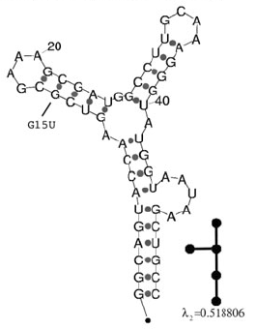
RNA tree-graphs
Capturing the exceptionally stable GUUUC loop with the non- canonical GC closing base pair corresponding to the experiment.

Slide 6
Algebraic connectivity
The algebraic connectivity of a graph G is the second smallest eigenvalue of the Laplacian matrix of G.
Let T = (V , E) be a tree on n vertices with algebraic connectivity a(T ). Then:
  (1) 0 ≤ a(T ) ≤ 1.
  (2) a(T ) = 0 iff T is not connected.
  (3) a(T ) = 1 iff T = K1,n−1 is a star on n vertices.
  (that is the tree T has n vertices: one vertex of degree n − 1 and n−1 pendant (degree 1) vertices.)

Slide 7

Laplacian matrix
Let T=(V,E) be a tree with vertex set V = {v₁, v₂, . . . , v_{n}} and edge set E. Denote by d(v) the degree of v, where v ∈ V is a vertex of T . The Laplacian matrix of T is L(T ) = (m_{ij}), where
d(v_{i}) if i = j
M_{ij} = -1 if v_{i}, v_{j} ∈ E
0 otherwise
Example
1 -1 0 0
L= -1 2 -1 0
0 -1 2 -1
0 0 -1 1
1
2
3
4

Slide 8
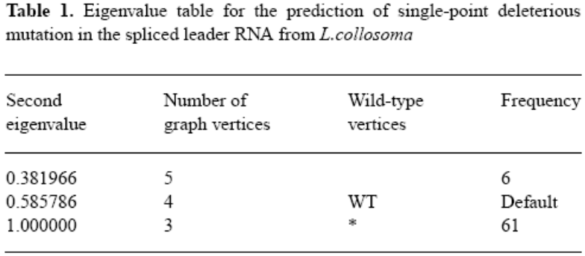
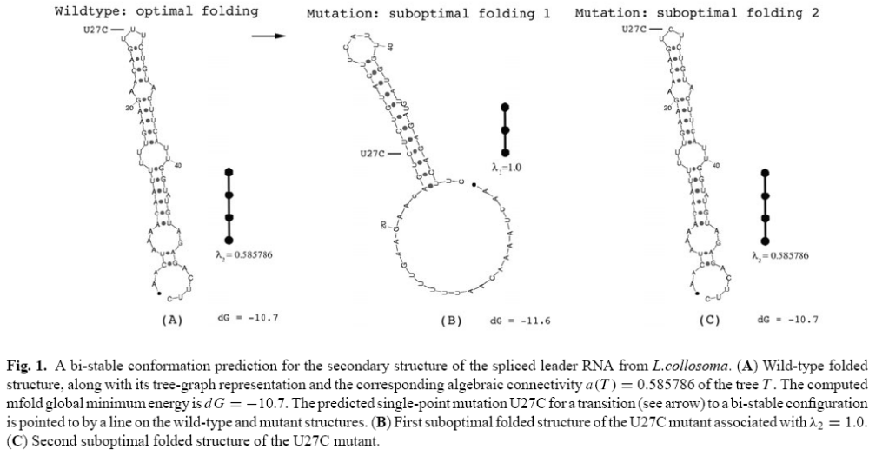
RESULTS
0.381966
WT
*

Slide 9
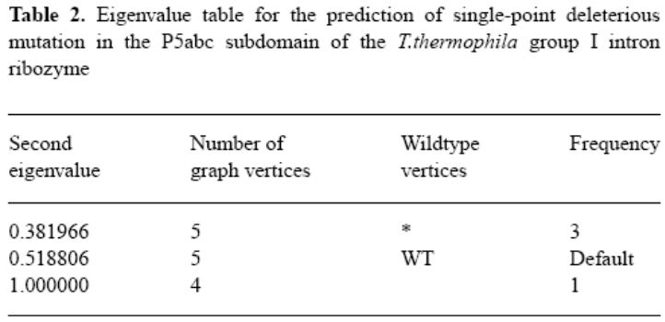
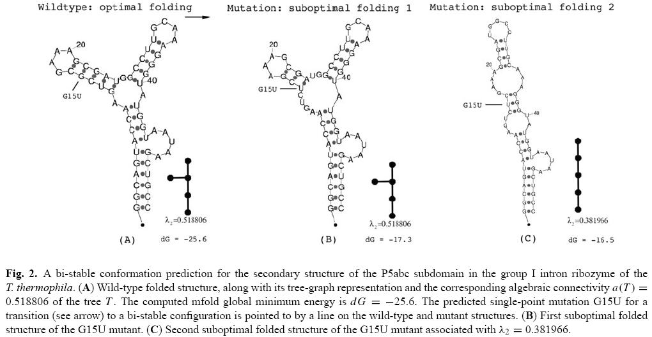
RESULTS
WT
*

Slide 10
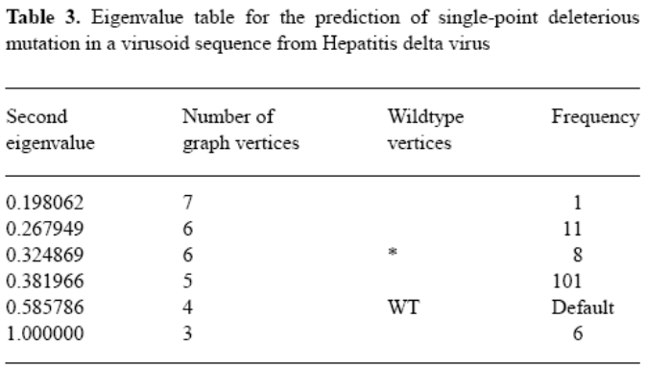
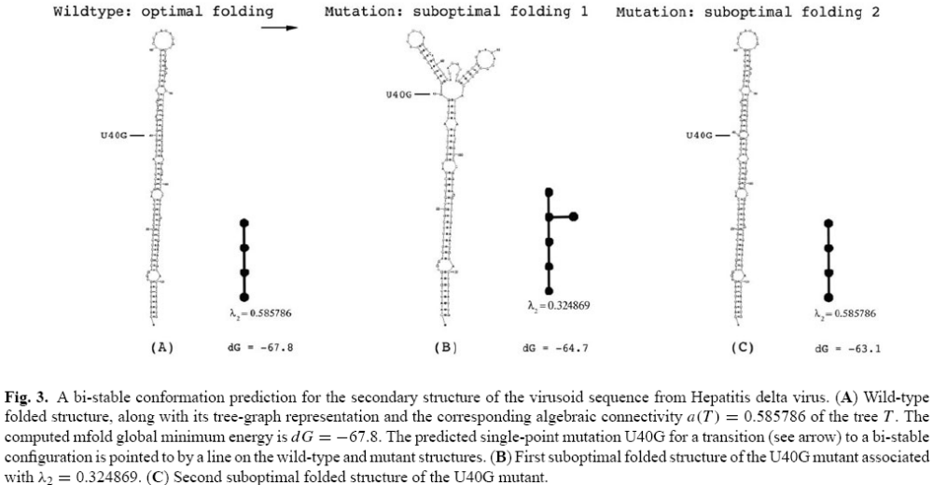
RESULTS
WT
*

